Slide 1


Green University of Bangladesh (GUB)
Dept. of Computer Science and Engineering
Course Name:
CSE 210: Database System Lab
Project Name:
Banking Database Management System
Submitted to:
Submitted by:
Ms Farhana Akter Sunny,
Sr. Lecturer,
Dept. of CSE,
Green University of Bangladesh.
Kazi hasnayeen emad,
ID : 191902025,
Dept. of CSE,
Green University of Bangladesh.
Date of Submission:
January 07, 2021

Slide 2
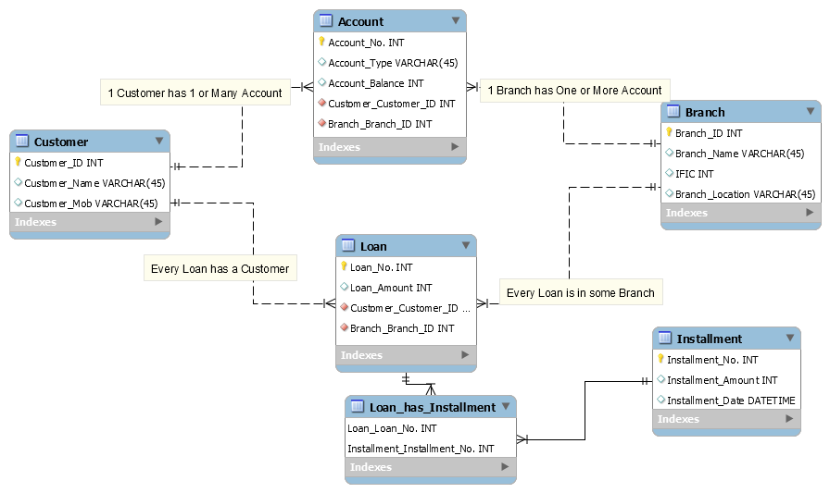
Banking Database Management System
Introduction:
This Project Is About Banking Database Management System. Sub Queries are attached with screenshot for better understanding.
Tools:
MySQL Workbench.
Feature:
DDL
DML
View
Procedural Language.
Language Used:
PL/SQL. (It is a high-performance and highly integrated database language.)
ER Diagram:

Slide 3
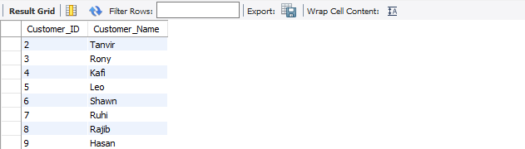
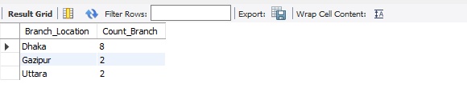
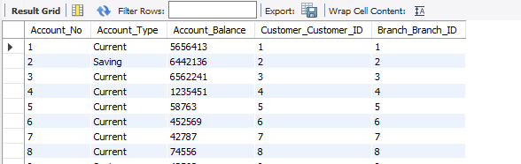
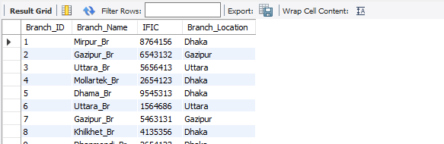
Views:
select *from Customer_ID_Name;
select *from br_location_count;
select *from Account_View;
select *from Branch_View;

Slide 4
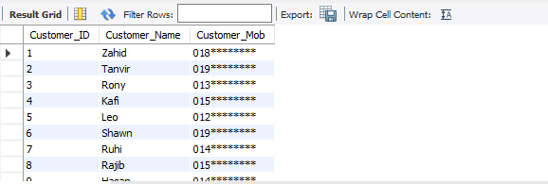
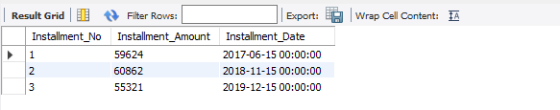

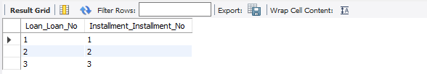
Views:
select *from Customer_View;
select *from Installment_View;
select *from Loan_View;
select *from loan_has_installment_View;

Slide 5

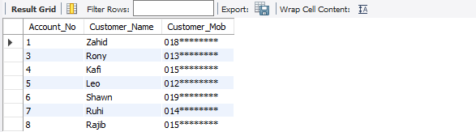
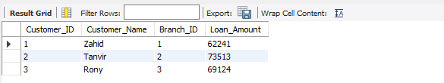
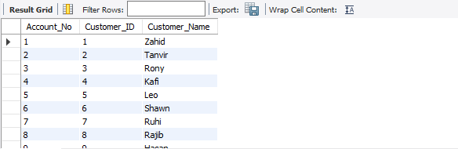
Procedural Function Call:
call Saving_Cust; -- showing Customers’ info who have Saving Accounts.
call Current_Cust; -- showing Customers’ info who have Current Accounts.
call Cust_Branch_Loan; -- showing Customer, Branch and Loan info.
call Cust_AC_No;

Slide 6
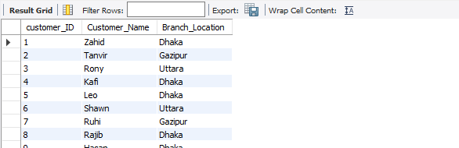
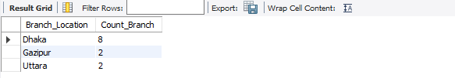
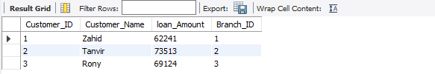
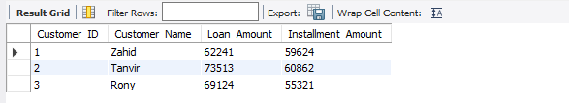
Procedural Function Call:
call Cust_Br_Location; -- showing Customers Branch info.
call Branch_Count;
call Get_Cust_Loan_and_Branch;
call Get_Cust_Loan_and_installment;

Slide 7


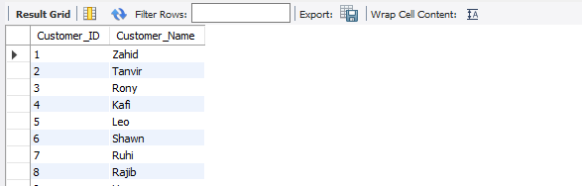
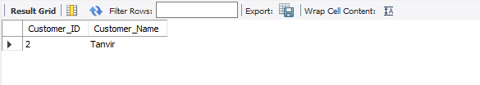
Procedural Function Call:
call Get_Cust_LoanAmount;
call GetCust_ID_Name('Uttara_Br');
Complex Queries:
-- Customer ID, and Name from 3 tables:
select Customer.Customer_ID, Customer.Customer_Name from Customer join account on Customer.Customer_ID=Account.Customer_Customer_ID join branch on branch.Branch_ID = Account.Branch_Branch_ID;
-- Customer id and name of branch 2:
select Customer.Customer_ID, Customer.Customer_Name from Customer join account on Customer.Customer_ID=Account.Customer_Customer_ID join branch on branch.Branch_ID = Account.Branch_Branch_ID where branch.Branch_ID=2;

Slide 8
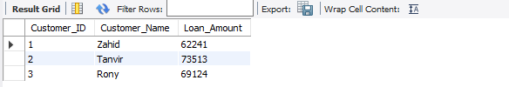
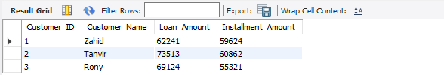
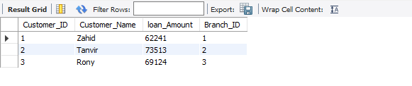
Complex Queries:
-- List of Customer who has taken loan and their amount:
select customer.Customer_ID, customer.Customer_Name, loan.Loan_Amount from customer join loan on Customer.Customer_ID=loan.Customer_Customer_ID;
-- List of Customers and their loan. Besides their installment amount:
select customer.Customer_ID, customer.Customer_Name, loan.Loan_Amount, installment.Installment_Amount from customer join loan on Customer.Customer_ID=loan.Customer_Customer_ID join loan_has_installment on loan_has_installment.Loan_Loan_No=Loan.Loan_No join Installment on Installment.Installment_No=loan_has_installment.Installment_Installment_No;
-- Name of the Customers and id and their loan and from which branch do they take the loan:
select customer.Customer_ID, Customer.Customer_Name, loan.loan_Amount, branch.Branch_ID from customer join loan on Customer.Customer_ID=loan.Customer_Customer_ID join branch on loan.Branch_Branch_ID=branch.Branch_ID;

Slide 9
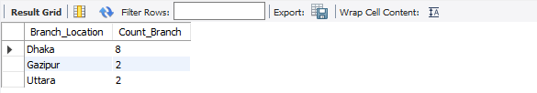
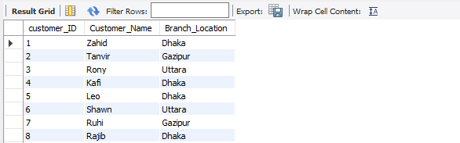
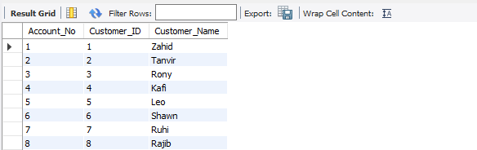
Complex Queries:
-- Number of branch in a city:
SELECT Branch_Location, count(*) AS Count_Branch FROM branch Group By Branch_Location;
-- Customer info from their branch:
Select customer.customer_ID, Customer.Customer_Name, branch.Branch_Location from customer join account on customer.customer_ID=account.Customer_Customer_ID join branch on account.Branch_Branch_ID=branch.Branch_ID;
-- Customers account no.:
SELECT account.Account_No, customer.Customer_ID, customer.Customer_Name FROM account INNER JOIN customer ON account.Account_No = customer.Customer_ID;

Slide 10
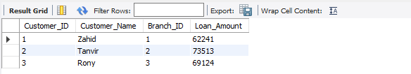
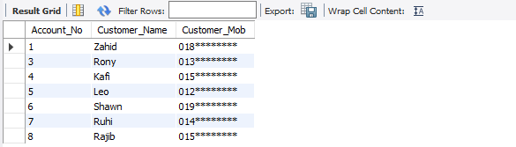

Complex Queries:
-- Customers id branch id and loan amount:
SELECT customer.Customer_ID, customer.Customer_Name, branch.Branch_ID, loan.Loan_Amount FROM ((loan INNER JOIN customer ON loan.Customer_Customer_ID=customer.Customer_ID) INNER JOIN branch ON loan.Branch_Branch_ID=branch.Branch_ID);
-- Customer info whose account type is Current:
SELECT account.Account_No, customer.Customer_Name, customer.Customer_Mob FROM account, customer WHERE account.Customer_Customer_ID = customer.Customer_ID AND account.Account_Type = 'Current';
-- Customer info whose account type is Saving:
SELECT account.Account_No, customer.Customer_Name, customer.Customer_Mob FROM account, customer WHERE account.Customer_Customer_ID = customer.Customer_ID AND account.Account_Type = 'Saving';

